Slide 1
Goal of Tuning and Current Model
Shuyao Kong
02/01/19

Slide 2
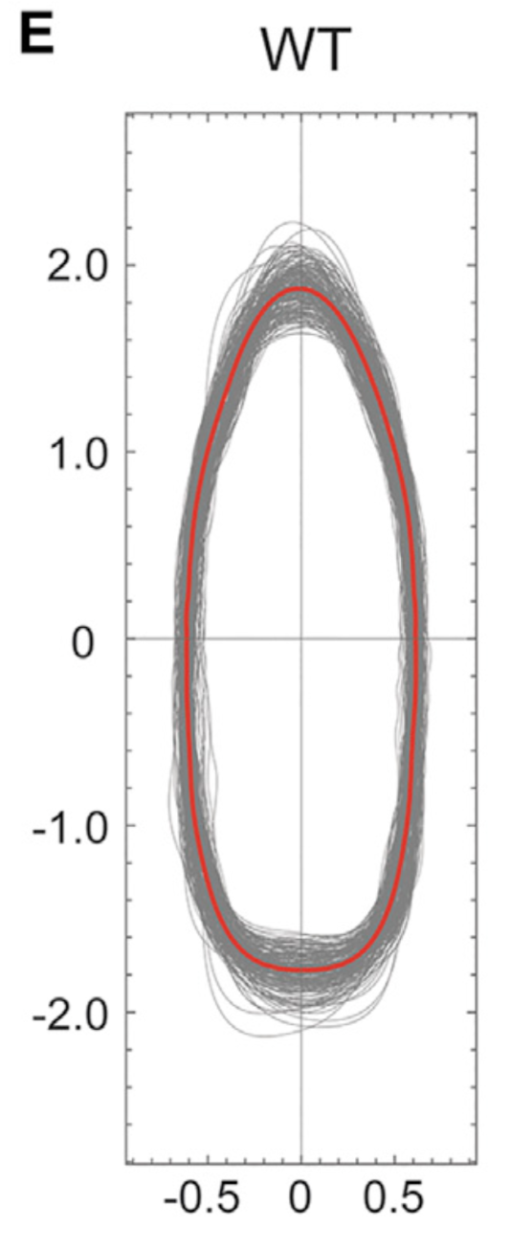
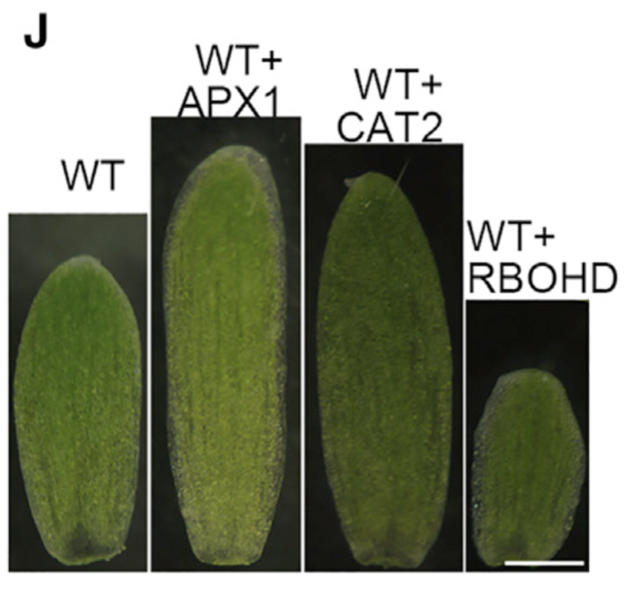
Arabidopsis WT sepal shape
In the left figure, length-width ratio is 3:1
Hong et al, Developmental Cell, 2016

Slide 3
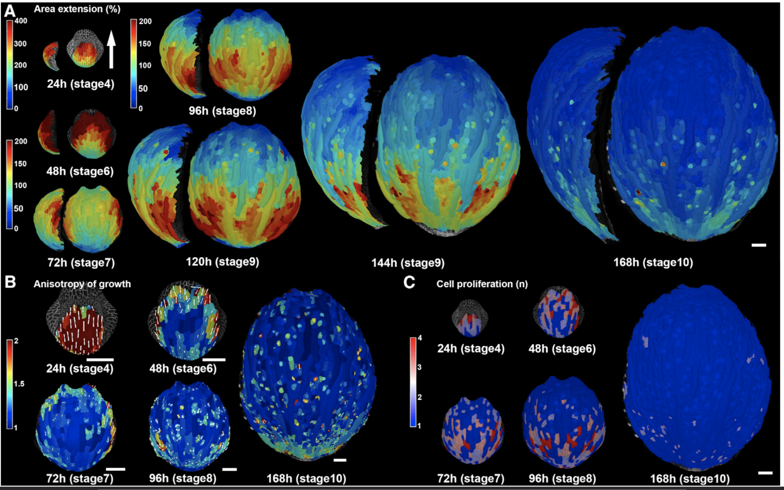
Arabidopsis sepal growth rate
Hervieux et al, Current Biology, 2016

Slide 4
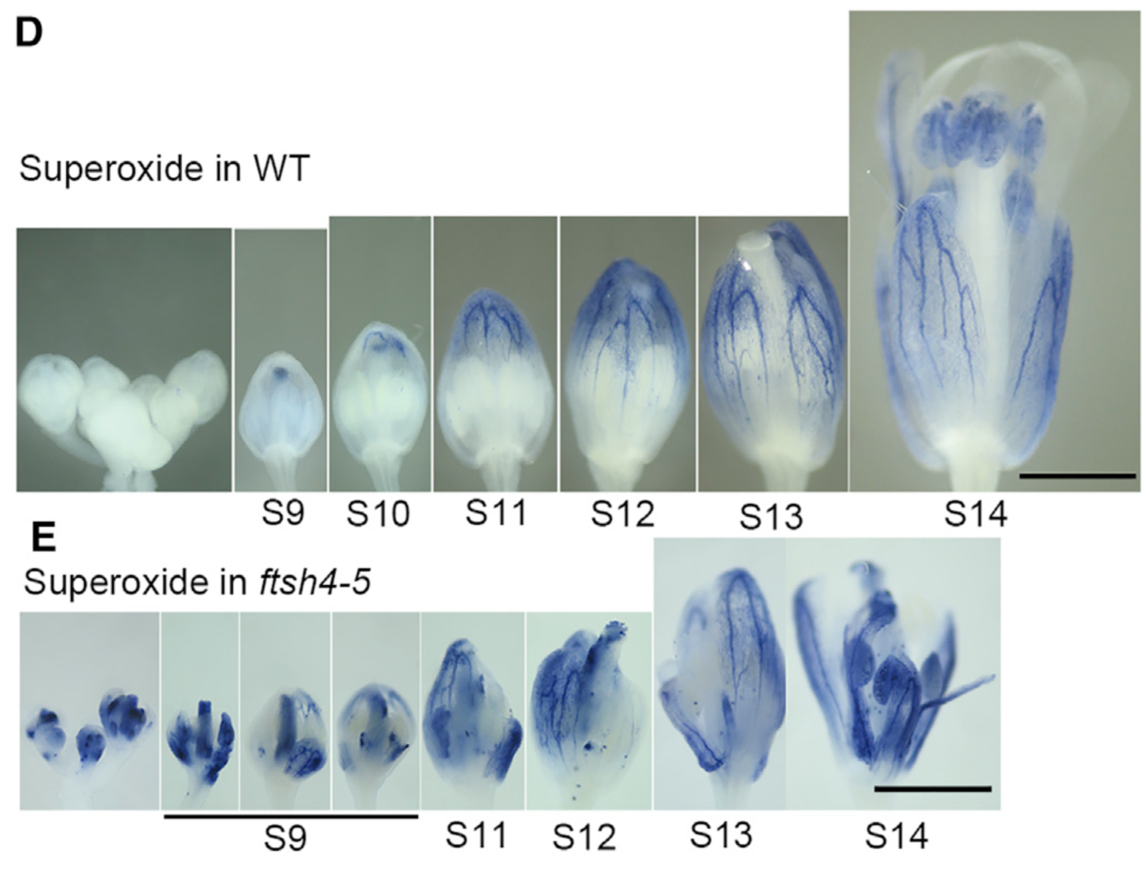
Arabidopsis sepal arrest front starts at stage 10
Arrest front starts when sepal length is half the mature length
Hong et al, Developmental Cell, 2016

Slide 5
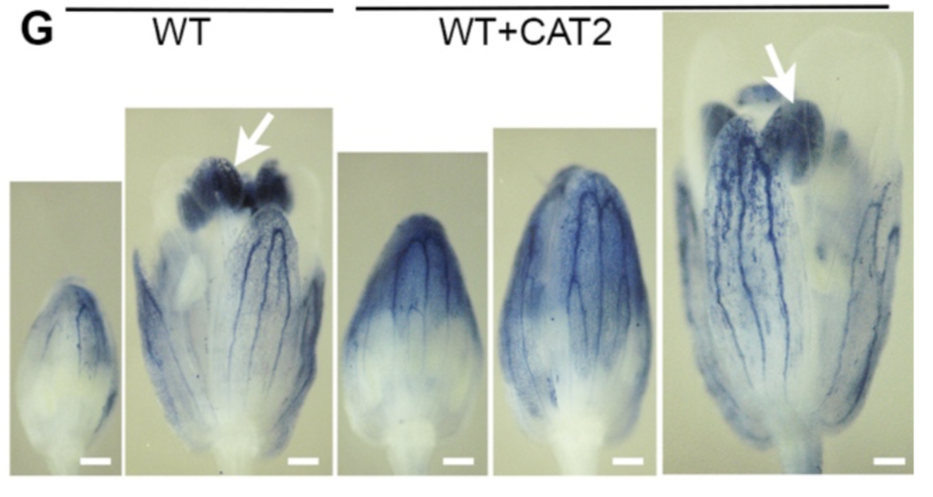
Arabidopsis sepal affected by ROS
Left: + means overexpression
APX1 and CAT2: two genes that decrease ROS.
RBOHD: a gene that produces ROS
Right: In sepals, CAT2 OE causes delayed initiation of arrest front
Hong et al, Developmental Cell, 2016

Slide 6
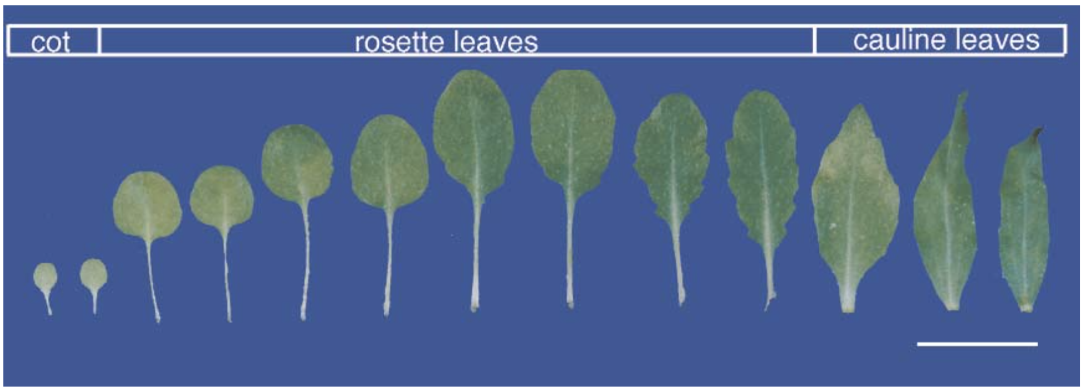
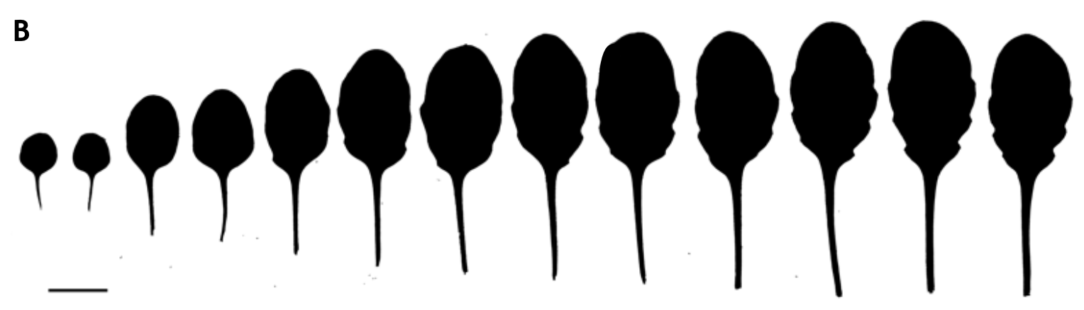
Arabidopsis leaf series
Tsukaya, The Arabidopsis Book, 2002
Maugarny-Cales and Laufs, Development, 2018

Slide 7
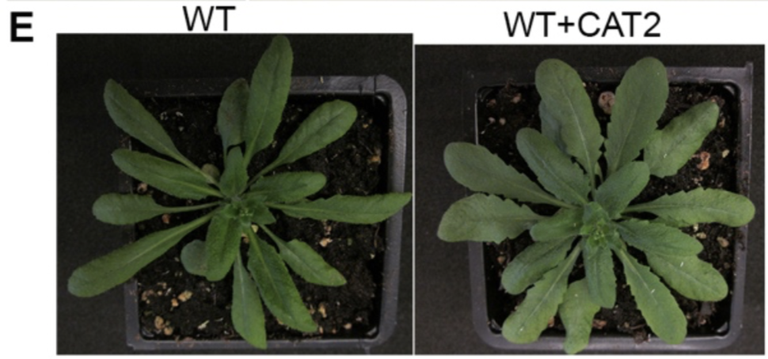
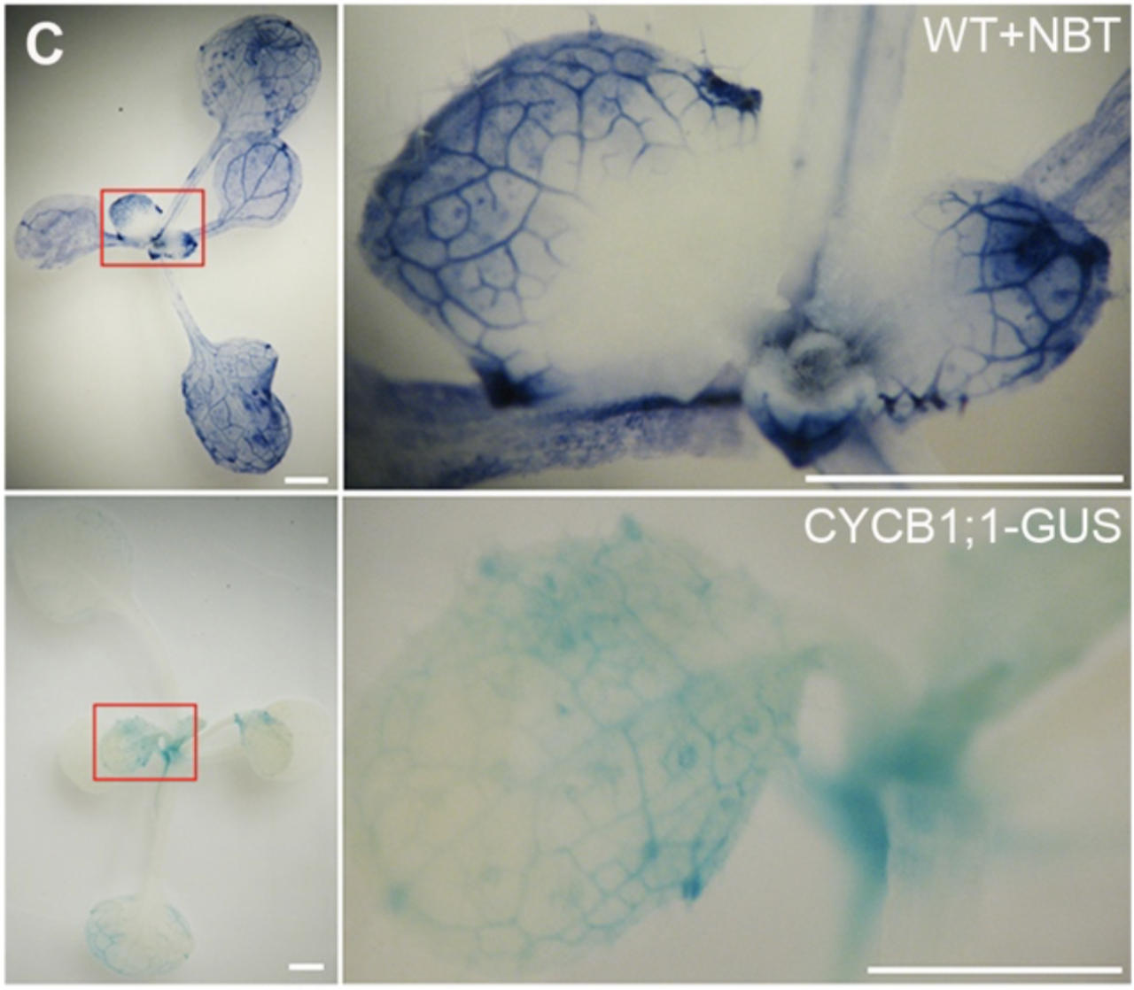
Arabidopsis leaf affected by ROS
Left: CAT2 OE affects leaf size. Note that CAT treatment causes delayed arrest front onset in sepals
Right: ROS anti-correlates with cell division activity
Hong et al, Developmental Cell, 2016

Slide 8
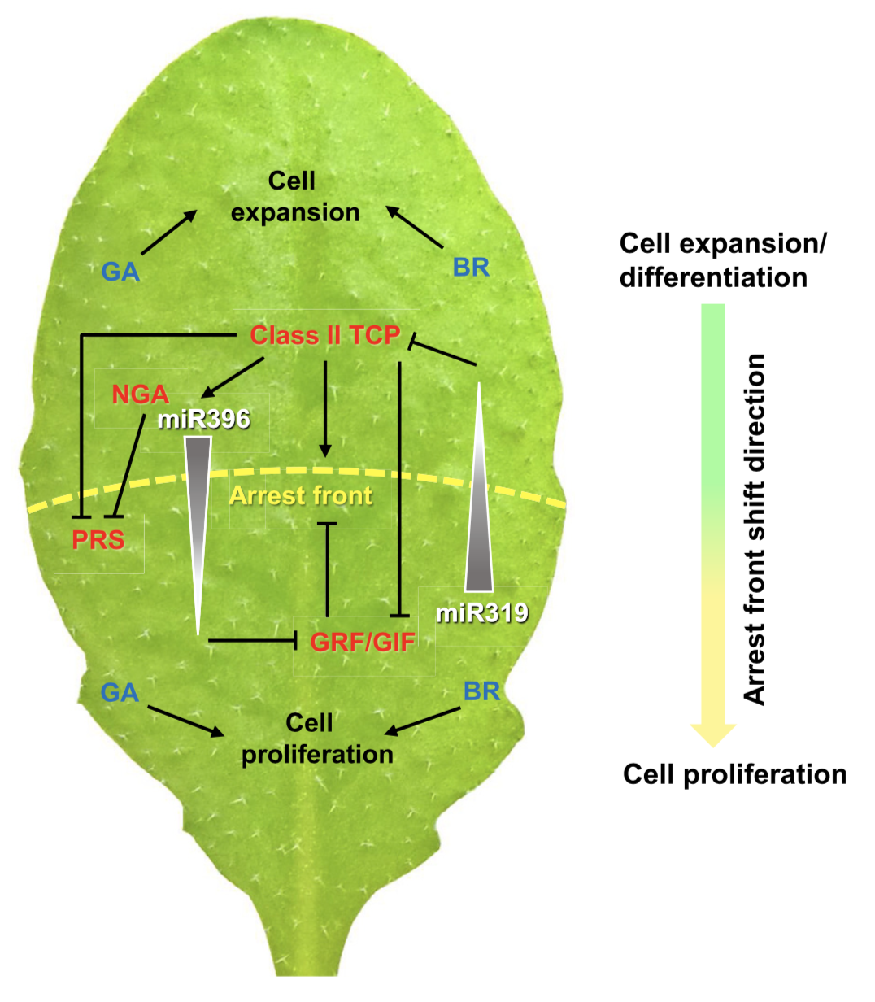
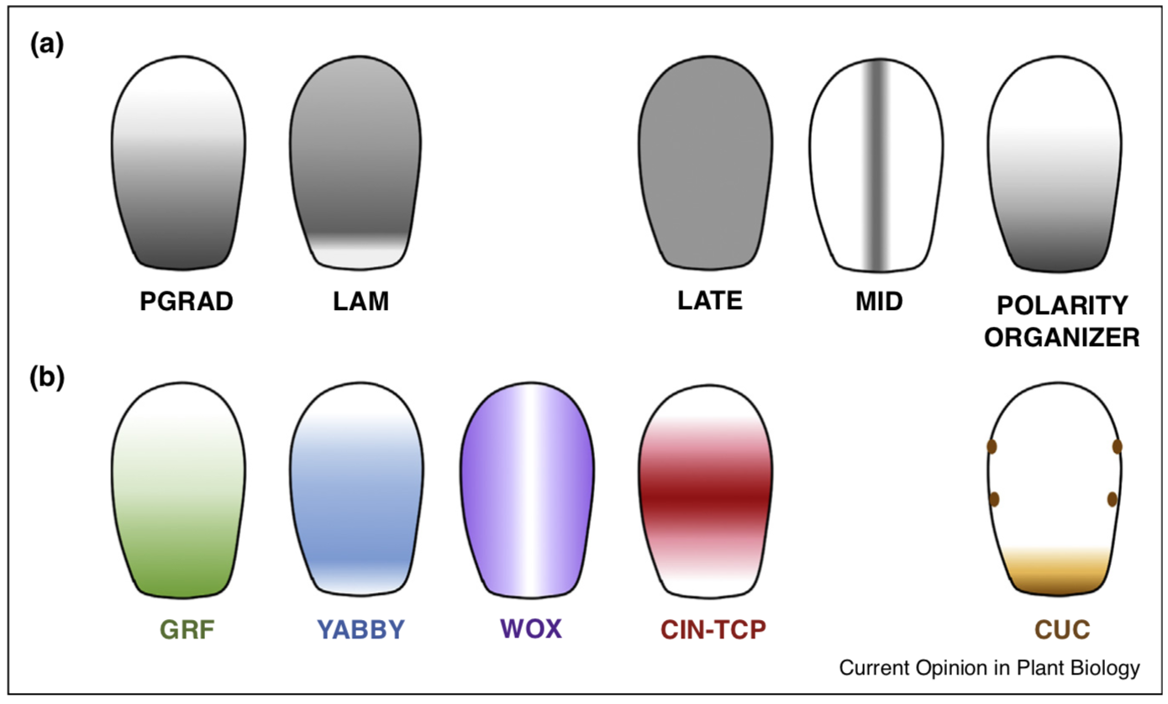
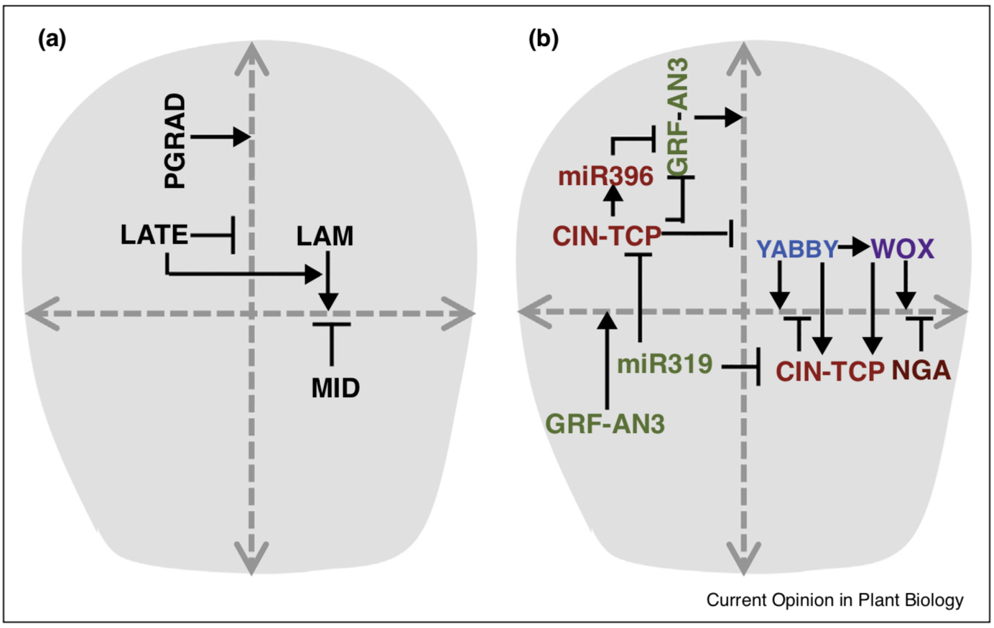
Current understanding of leaf developmental program
Du et al.,
Mol Plant, 2018
Sarvepalli et al.,
Curr Op Plant Biol, 2019

